Slide 1


SOCIALWAVE
FINAL PRESENTATION
Presented By:
Ann Jacob
Aron Jude Maxwel
Bilna Bijoy
Cerin Saji
Dept. of CSE, RSET
Guided by:
Ms. Anu Maria Joykutty
Asst. Professor
Dept. of CSE, RSET

Slide 2

CONTENTS
ASSUMPTIONS
WORK BREAKDOWN
HARDWARE AND SOFTWARE REQUIREMENTS
GANTT CHART
RISK AND CHALLENGES
EXPECTED OUTPUT
CONCLUSION
REFERENCES
PROBLEM DEFINTION
PURPOSE AND NEED
PROJECT OBJECTIVE
LITERATURE SURVEY
PROPOSED METHOD
ARCHITECTURE DIAGRAM
SEQUENCE DIAGRAM
MODULES
SOCIALWAVE - FINAL PRESENTATION
2

Slide 3

PROBLEM DEFINTION
New and emerging content creators find it difficult to increase or predict the engagement rates of their posts as the creator space is highly saturated in the current age. They are also challenged when it comes to finding trending hashtags and captions that complement their posts well.
SOCIALWAVE - FINAL PRESENTATION
3

Slide 4

PURPOSE AND NEED
The proposed solution is a tool that enables Instagram content creators to optimize their posts for higher engagement by predicting engagement rates based on images and hashtags, and generating creative captions, helping them increase their reach and post virality.
SOCIALWAVE - FINAL PRESENTATION
4

Slide 5

PROJECT OBJECTIVE
Develop an engagement prediction model:
Use a machine learning technique (Random Forest) to predict the engagement rate of Instagram posts based on images and hashtags.
1
Build a caption generation and hashtag recommendation feature:
Use NLP models to generate creative and contextually relevant captions and recommend hashtags based on uploaded images or user-provided prompts.
3
Implement image analysis:
Utilize an object detection algorithm (Faster-RCNN) to extract relevant image features.
2
SOCIALWAVE - FINAL PRESENTATION
5

Slide 6
PROJECT OBJECTIVE
Create a user-friendly web application:
Provide an intuitive interface for content creators to upload images, enter hashtags, and receive engagement predictions and caption suggestions in real-time.
4
Optimize posts for virality:
Help content creators increase the likelihood of their posts going viral by providing insights into hashtag performance and content quality.
5
SOCIALWAVE - FINAL PRESENTATION
6

Slide 7
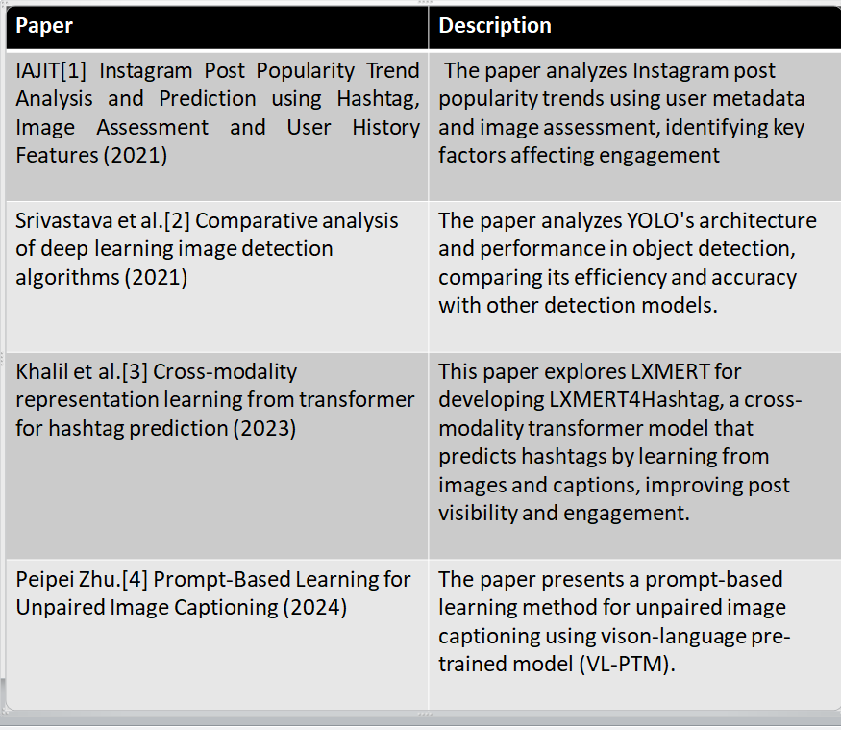

LITERATURE SURVEY
SOCIALWAVE - FINAL PRESENTATION
7

Slide 8
LITERATURE SURVEY
SOCIALWAVE - FINAL PRESENTATION
8

Slide 9

PROPOSED METHOD
Random Forest for ER Prediction:
1. Collect a dataset of Instagram posts, including features such as generated hashtags, captions, and engagement metrics (likes, comments, followers).
2.Preprocess the data by cleaning, normalizing, and encoding categorical variables (e.g., hashtags, captions) into numerical formats suitable for analysis.
3.Split the dataset into training and testing sets to evaluate model performance.
4.Initialize the Random Forest algorithm with specified hyperparameters (number of trees, maximum depth, etc.).
SOCIALWAVE - FINAL PRESENTATION
9

Slide 10
PROPOSED METHOD
Random Forest for ER Prediction:
5.Fit the Random Forest model on the training dataset using features (hashtags, captions) to predict engagement rates.
6.Use the trained model to make predictions on the testing dataset and compare predicted engagement rates with actual values.
7.Evaluate model performance using metrics such as Mean Squared Error (MSE) and R-square values.
8.Perform feature importance analysis to identify which features (hashtags, captions) most influence engagement rates.
SOCIALWAVE - FINAL PRESENTATION
10

Slide 11
PROPOSED METHOD
Random Forest for ER Prediction:
9.Optionally tune hyperparameters and retrain the model to improve accuracy based on evaluation results.
10.Use the final model for predicting engagement rates of new Instagram posts based on their generated hashtags and captions.
SOCIALWAVE - FINAL PRESENTATION
11

Slide 12
PROPOSED METHOD
Generating Instagram Captions with Fine-Tuned Microsoft-git-base
Install Necessary Libraries: Set up your environment by installing essential libraries such as Transformers, Accelerate, and Dataset
Load the Dataset: Utilize a dataset containing Instagram post captions and corresponding images from the Hugging Face Hub.​
Preprocess the Data: Implement a custom dataset class to preprocess images and captions, including resizing images and tokenizing captions.​
Create DataLoader: Set up a DataLoader to facilitate batch processing during model training.​
SOCIALWAVE - FINAL PRESENTATION
12

Slide 13
PROPOSED METHOD
Load Pre-trained GIT Model: Initialize the pre-trained Microsoft GIT model for causal language modeling.​
Fine-Tune the Model: Train the model on your dataset, optimizing it to generate captions that align with Instagram's style and your specific content.​
Generate Captions: After fine-tuning, input images into the model to produce engaging and contextually relevant Instagram captions.
SOCIALWAVE - FINAL PRESENTATION
13

Slide 14
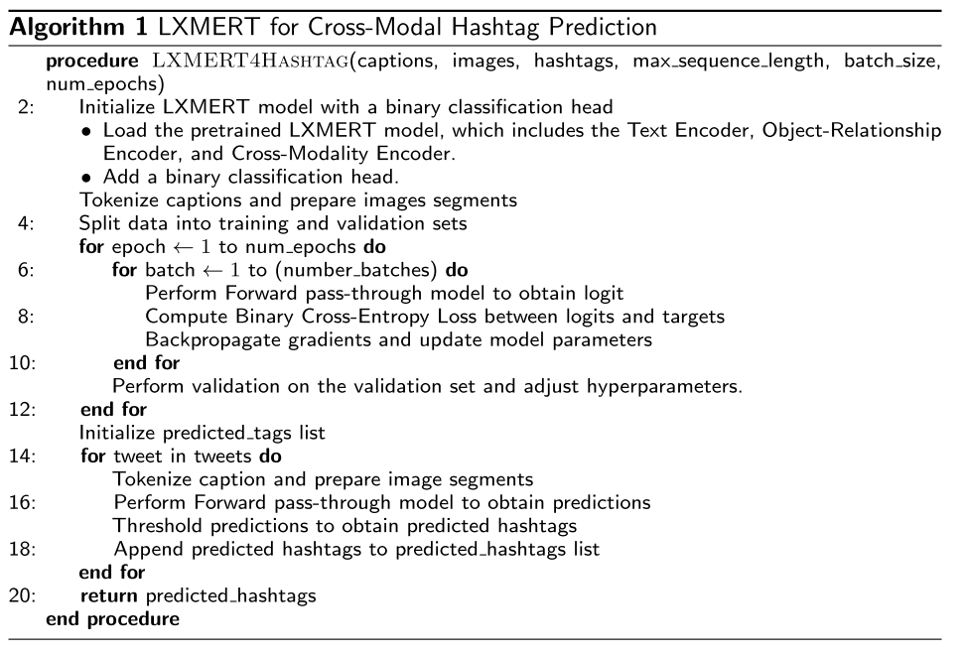
PROPOSED METHOD
LXMERT4Hashtag for Hashtag Recommendation

Slide 15
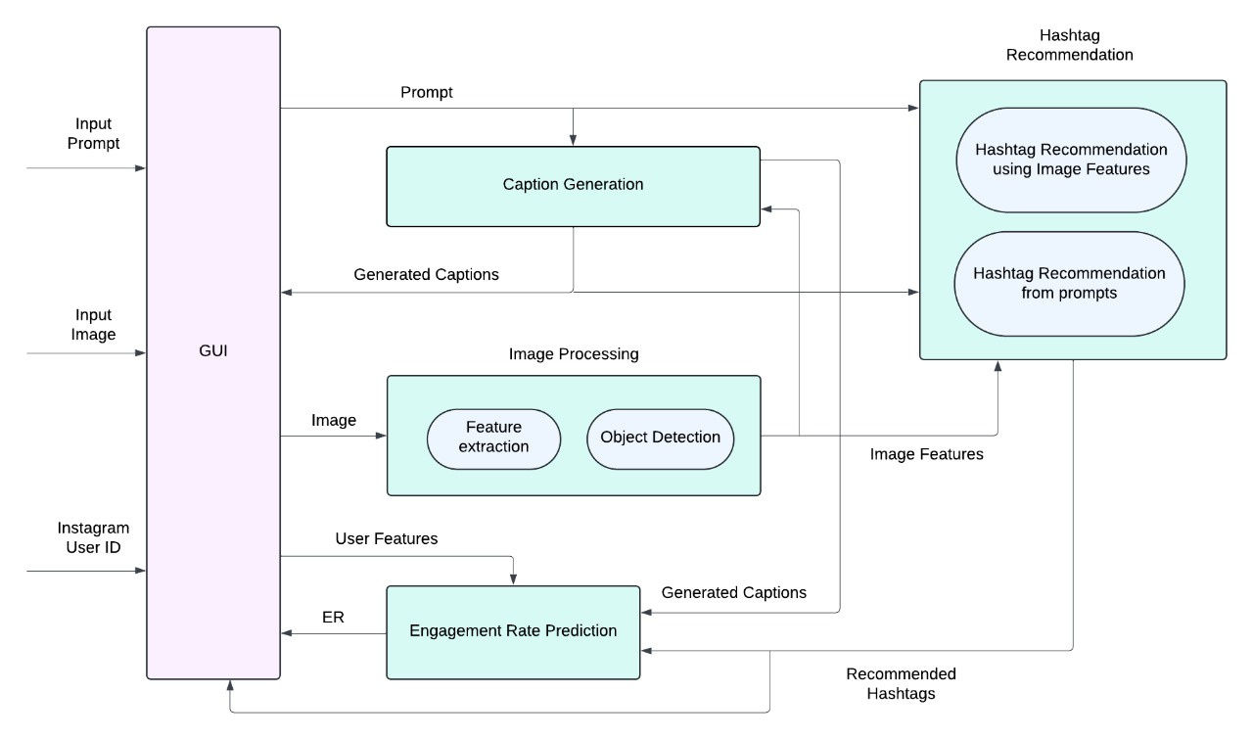
ARCHITECTURE DIAGRAM

Slide 16
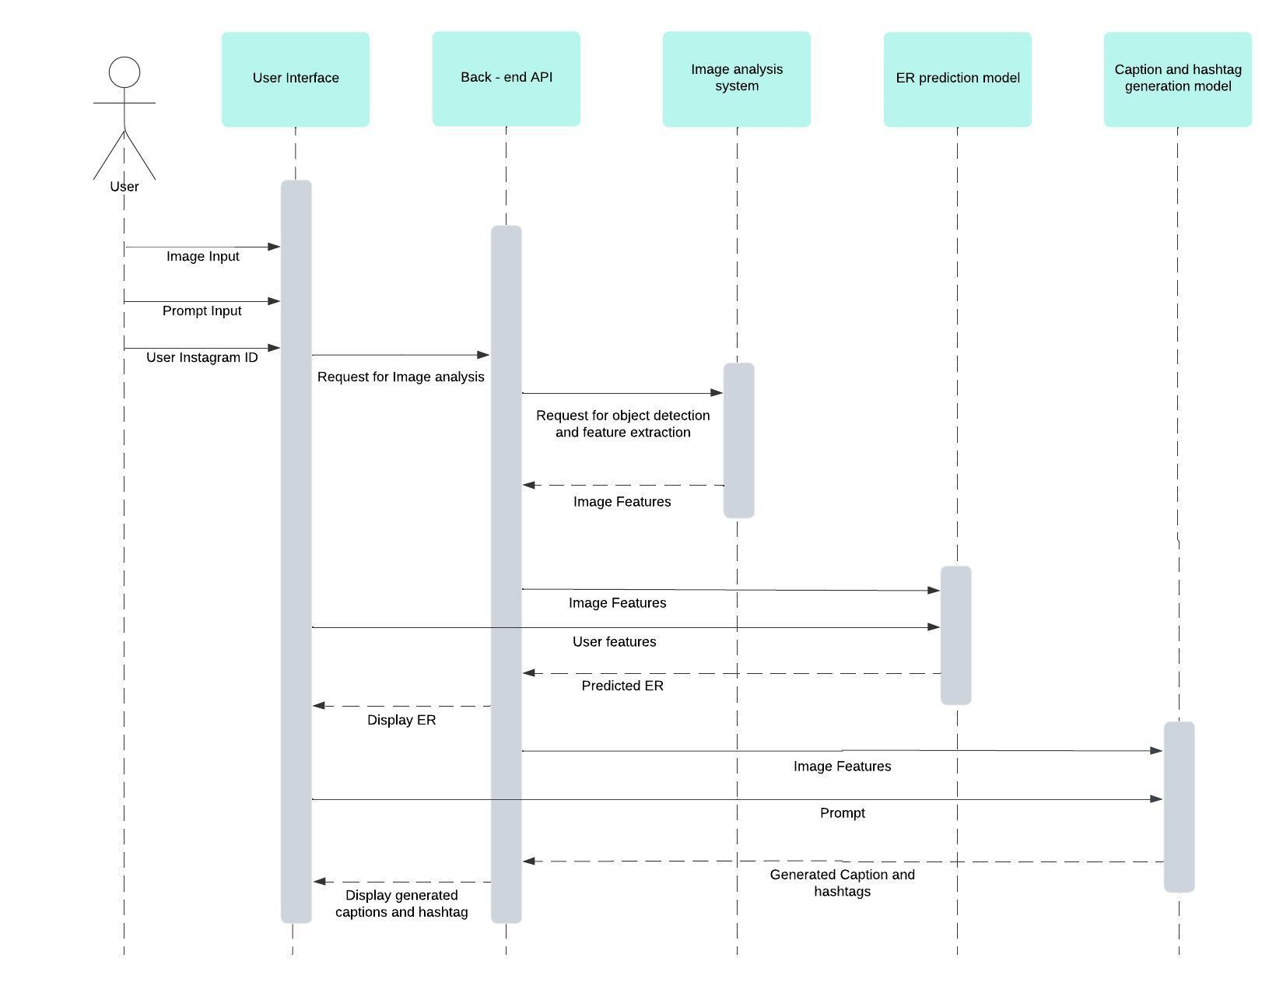
SEQUENCE
DIAGRAM

Slide 17

MODULES
1. IMAGE ANALYSIS MODULE
Object Detection for Post Insights: The model detects and classifies objects in Instagram images, identifying key elements like products, people, or backgrounds to enhance content understanding.
Content Relevance Evaluation: It extracts visual features from the post, aiding in analyzing how well the image aligns with the hashtags, captions, and audience engagement.
SOCIALWAVE - FINAL PRESENTATION
17

Slide 18
MODULES
2. HASHTAG GENERATION MODULE
Hashtag Suggestion from Image Content: The module analyzes the visual content of images and automatically generates relevant hashtags that align with the image’s subject, theme, and key features to boost visibility.
Custom Hashtag Generation from Prompts: Users can input specific prompts, and the module generates tailored hashtags based on the given context or theme, enhancing engagement for targeted audiences.
SOCIALWAVE - FINAL PRESENTATION
18

Slide 19
MODULES
3. CAPTION GENERATION MODULE
Automated Caption Creation from Images: The module analyzes visual elements within an image and generates relevant, engaging captions that reflect the content, context, and mood of the image.
Personalized Caption Generation from Prompts: Based on user-provided prompts, the module crafts customized captions that align with the desired tone, theme, or message, allowing for more targeted and creative content.
SOCIALWAVE - FINAL PRESENTATION
19

Slide 20
MODULES
4. ENGAGEMENT RATE PREDICTION
Hashtag and Caption Analysis: Predicts engagement using Random Forest by evaluating the effectiveness of hashtags and relevance of captions.
User Feature Integration: Considers user-specific factors like follower count, posting frequency, and past engagement to enhance prediction accuracy.
SOCIALWAVE - FINAL PRESENTATION
20

Slide 21

ASSUMPTIONS
The Instagram accounts for which engagement rates are being predicted are public and allow access to necessary post and user data (e.g., post likes, comments, hashtags, and user followers).
1
Images provided to the system must be of good quality which includes a minimum resolution of 1080x1080 pixels for detailed object detection, free from blurring and excessive noise for clear identification.
2
SOCIALWAVE - FINAL PRESENTATION
21

Slide 22

HARDWARE REQUIREMENTS
Processor: A modern multi-core processor (e.g., Intel Core i5) for efficient code compilation and development tasks.
RAM : A minimum 8GB of RAM to handle multiple development tools and applications simultaneously without slowdowns. However, 16 would be recommended.
Storage: A solid-state drive (SSD) with sufficient storage capacity (e.g., 256GB or higher) for storing project files, libraries, and development tools.
SOCIALWAVE - FINAL PRESENTATION
22

Slide 23

SOFTWARE REQUIREMENTS
Python, Flask, HTML5, CSS3 and JavaScript and frameworks like React for front-end development.
Libraries (TensorFlow and PyTorch) for training deep learning models (LXMERT4Hashtag, Random Forest).
Pre-trained model (Faster RCNN) for object detection and feature extraction tasks.
SOCIALWAVE - FINAL PRESENTATION
23

Slide 24

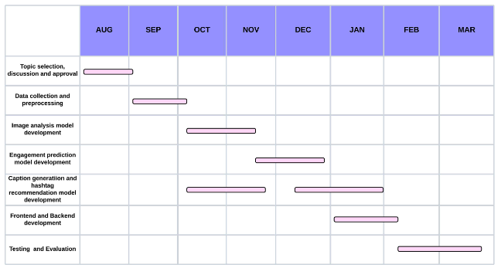
GANTT CHART
24

Slide 25


RISKS AND CHALLENGES
Handling and processing user-uploaded content (images, captions, hashtags) raises concerns about intellectual property rights and data privacy.
Virality can be influenced by many unpredictable factors, such as timing, external events, or platform algorithm changes, making it difficult to predict accurately.
Understanding hashtag meaning and context can be challenging, as hashtags may contain slang, abbreviations, or ambiguous meanings.
Users expect quick feedback when optimizing their social media posts, so delays could lead to frustration.
SOCIALWAVE - FINAL PRESENTATION
25

Slide 26

EXPECTED OUTPUT
1. Accurate Engagement Prediction
Develop a machine learning model for predicting engagement rates of Instagram posts.
Use likes,comments,images and hashtags as input to make predictions.
Help content creators improve their posts to increase likes, comments, and shares.
Provide actionable insights for optimizing post performance.
SOCIALWAVE - FINAL PRESENTATION
26

Slide 27
EXPECTED OUTPUT
2. Effective Image Caption Generation
Implement an NLP-based caption generator for Instagram posts.
Create contextually relevant, creative, and engaging captions.
Generate captions based on:
-Uploaded images.
-User-provided prompts or text.
Enhance content creation by providing high-quality, tailored captions.
SOCIALWAVE - FINAL PRESENTATION
27

Slide 28
EXPECTED OUTPUT
3. User-Friendly Web Application
Build a fully functional, interactive web application.
Key features:
-Upload images and input hashtags.
-Get real-time engagement rate predictions.
-Generate captions instantly.
-Ensure a seamless, intuitive, and easy-to-navigate UI.
Enable smooth interaction with the machine learning models and caption generation system.
SOCIALWAVE - FINAL PRESENTATION
28

Slide 29

WORK BREAKDOWN
ANN JACOB
Caption Generation Module
BILNA BIJOY
Object Detection module, ER prediction module (SVR, XG Boost)
2
1
CERIN SAJI
Hashtag Recommendation using ViT Classifier and LXMERT4Hashtag on HARRISON, Landing page UI, Front-end + Backend integration
ARON JUDE MAXWEL
Web scraping images from Instagram for dataset, ER prediction module (Random forest, Linear regression), UI - Login page, signup page, main page
3
4
SOCIALWAVE - FINAL PRESENTATION
29

Slide 30
PAPER SUBMISSION
Submitted paper to ASAR - International Conference on Advanced Research in Computer Science and Information Technology (ICARCSIT), New Delhi, India, April 15th, 2025
4th 2025 IEEE World Conference on Applied Intelligence and Computing: Submission (726) has been created.
SOCIALWAVE - FINAL PRESENTATION
30

Slide 31
OUTPUTS
SOCIALWAVE - FINAL PRESENTATION
31

Slide 32
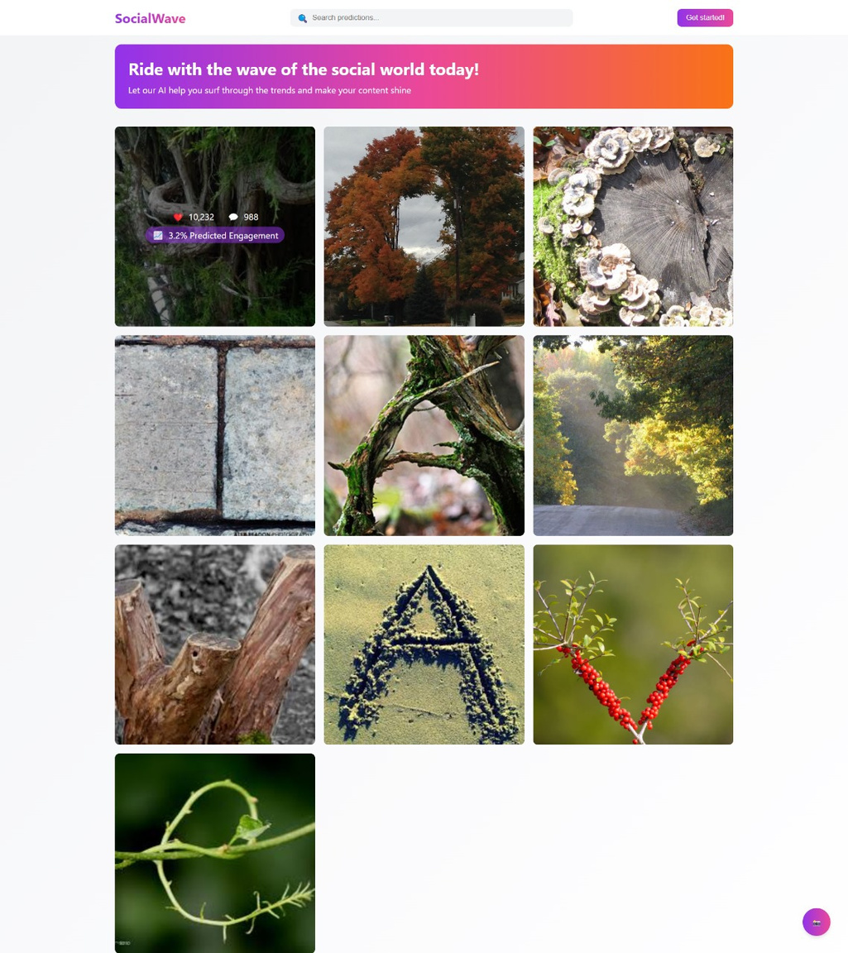
Landing page
SOCIALWAVE - FINAL PRESENTATION
32

Slide 33

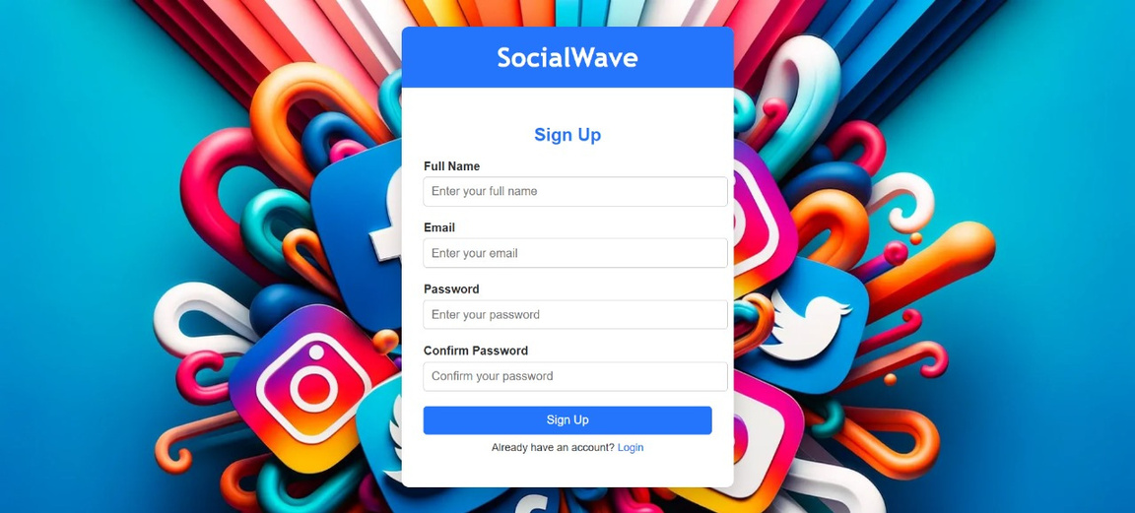
Login and Signup
Pages
SOCIALWAVE - FINAL PRESENTATION
33

Slide 34
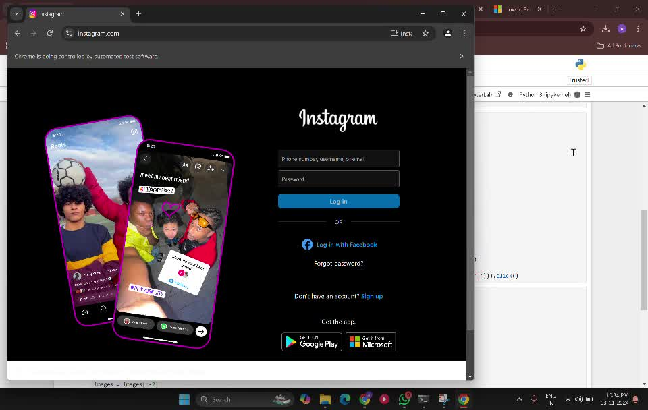
INSTAGRAM SCRAPING USING SELENIUM

Slide 35
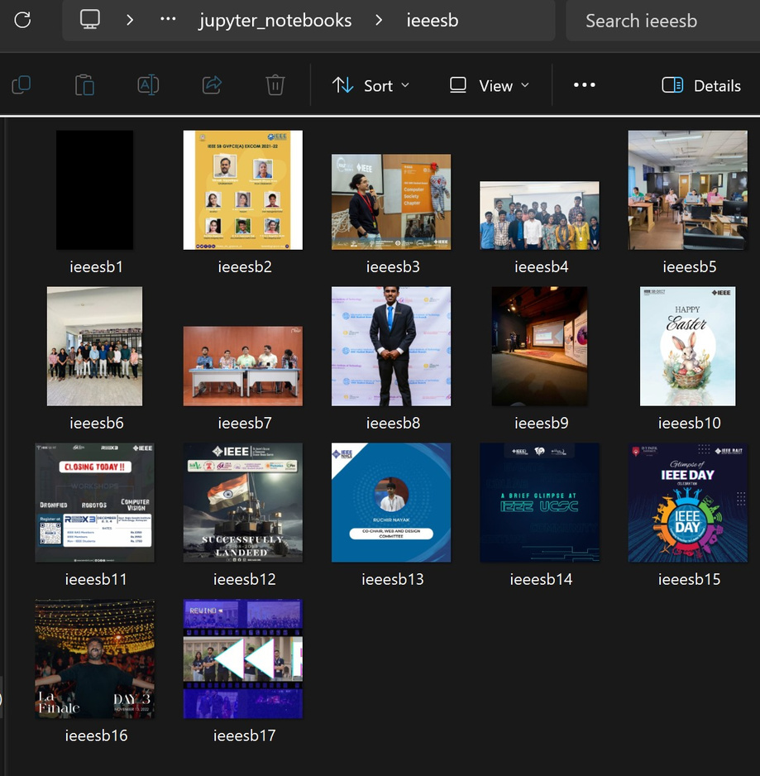
Images obtained after scraping posts under the hashtag ‘ieeesb’
SOCIALWAVE - FINAL PRESENTATION
35

Slide 36
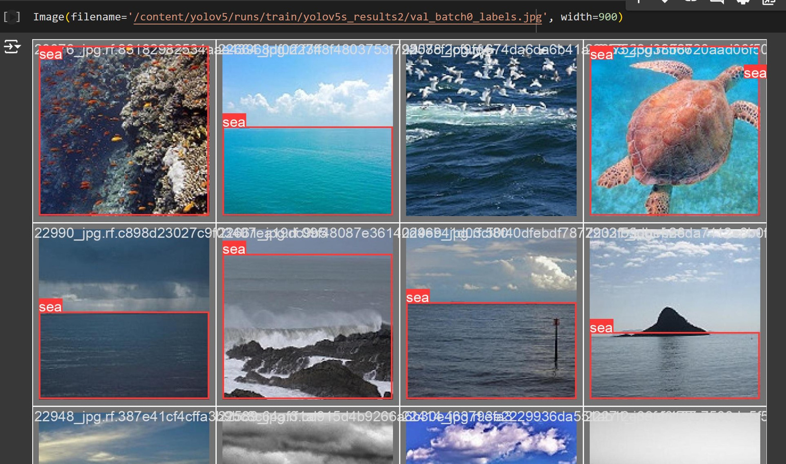
Object detection using YOLOv5
36

Slide 37
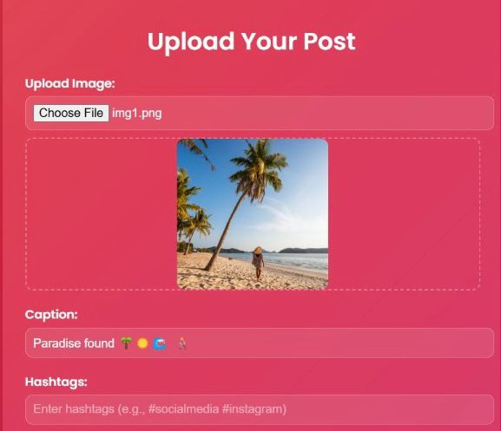
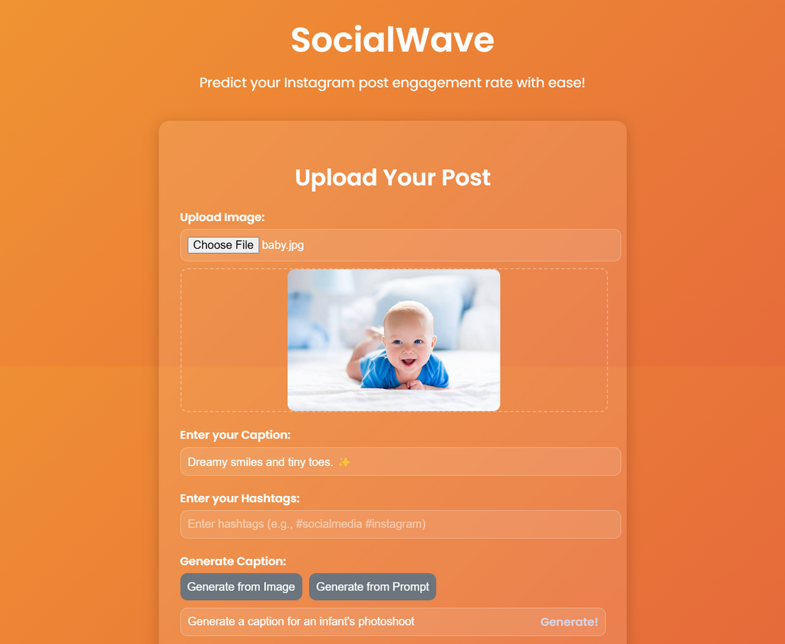
Captions generation from Images
Caption generation from prompts
SOCIALWAVE - FINAL PRESENTATION
37

Slide 38
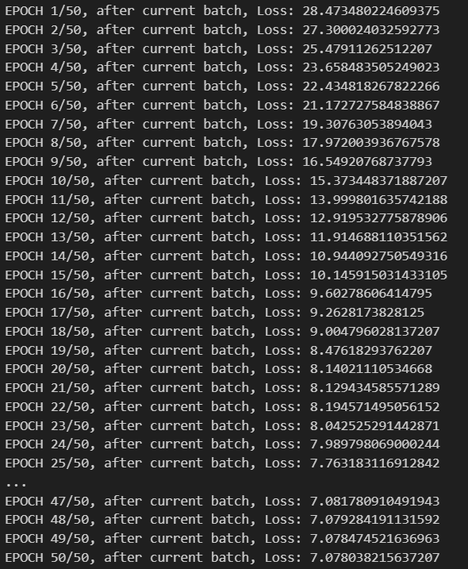
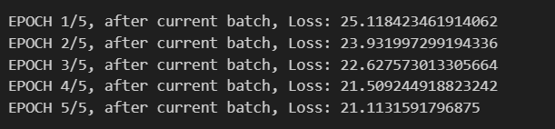
Hashtag Generation - Training using ViT Classifier
1st Test Training - Extremely High Loss
High loss obtained when trained considering Cross Entropy Loss
38

Slide 39
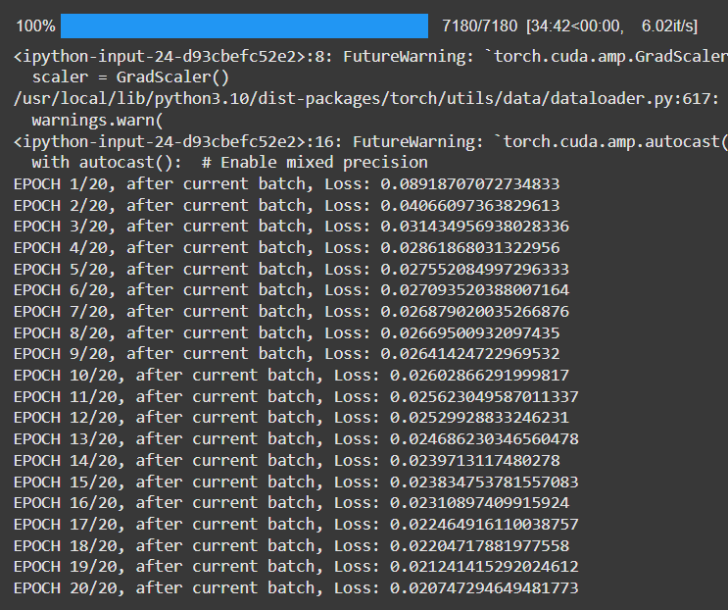
Hashtag Generation - Training using ViT Classifier
The loss significantly decreased when trained using BCE with Logits Loss since this is a multi-class classification problem
39

Slide 40
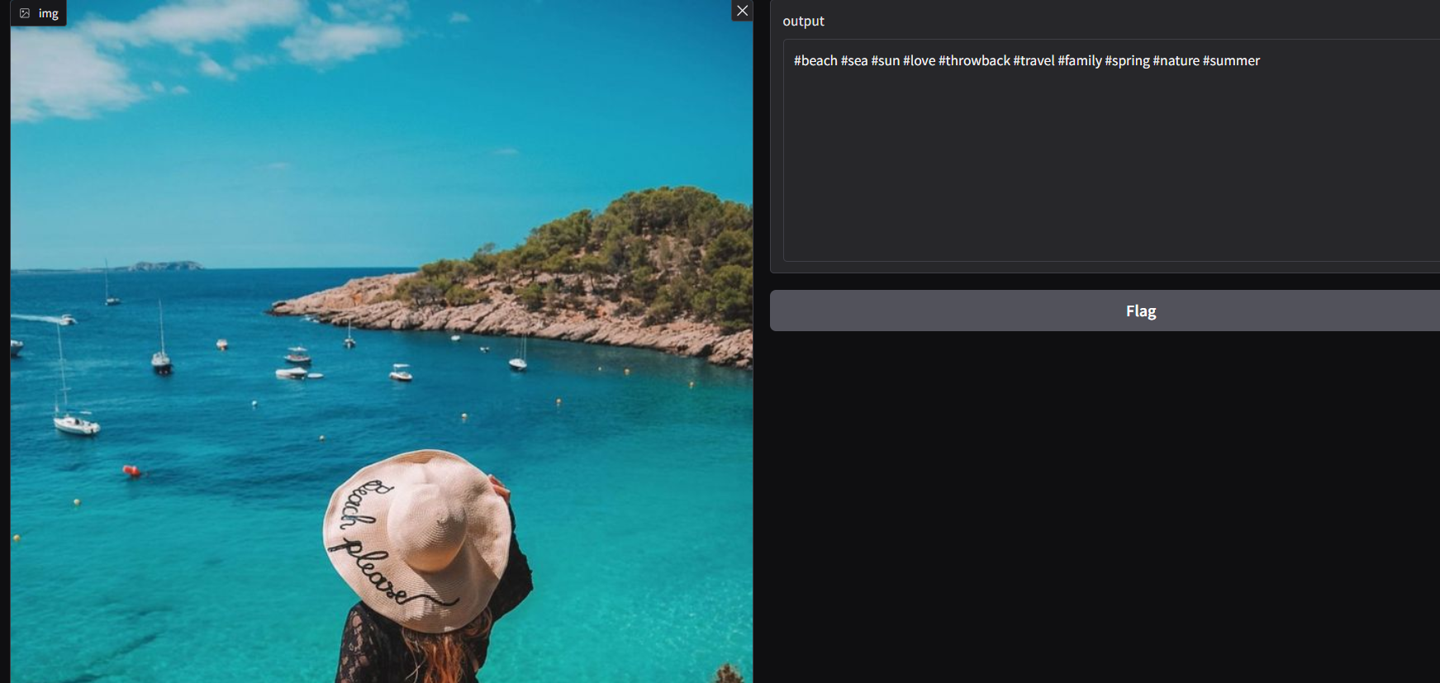
Hashtag Generation - Training using ViT Classifier

Slide 41
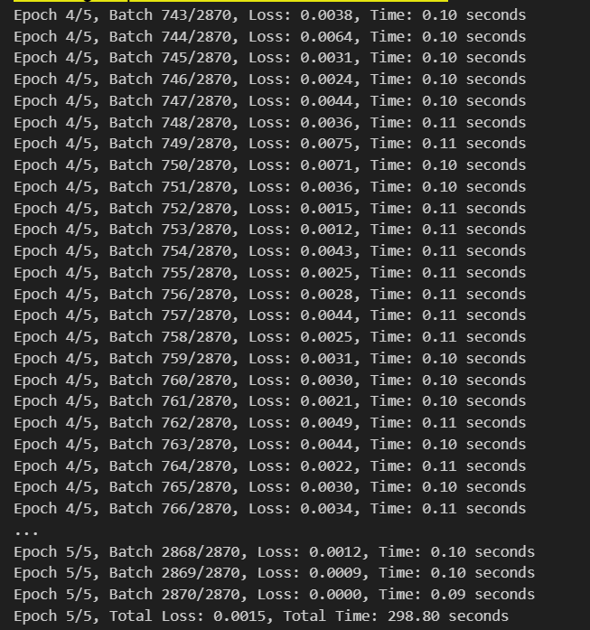
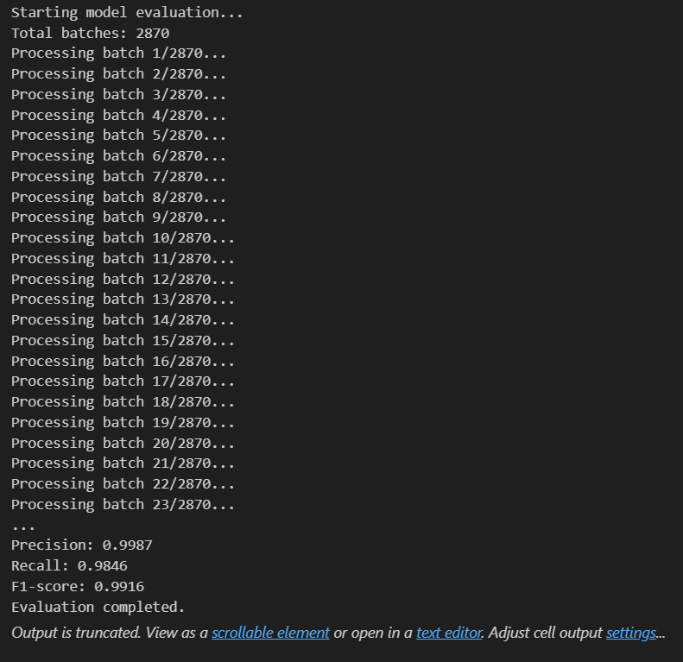
Hashtag Generation - fine-tuning LXMERT (LXMERT4Hashtag)

Slide 42
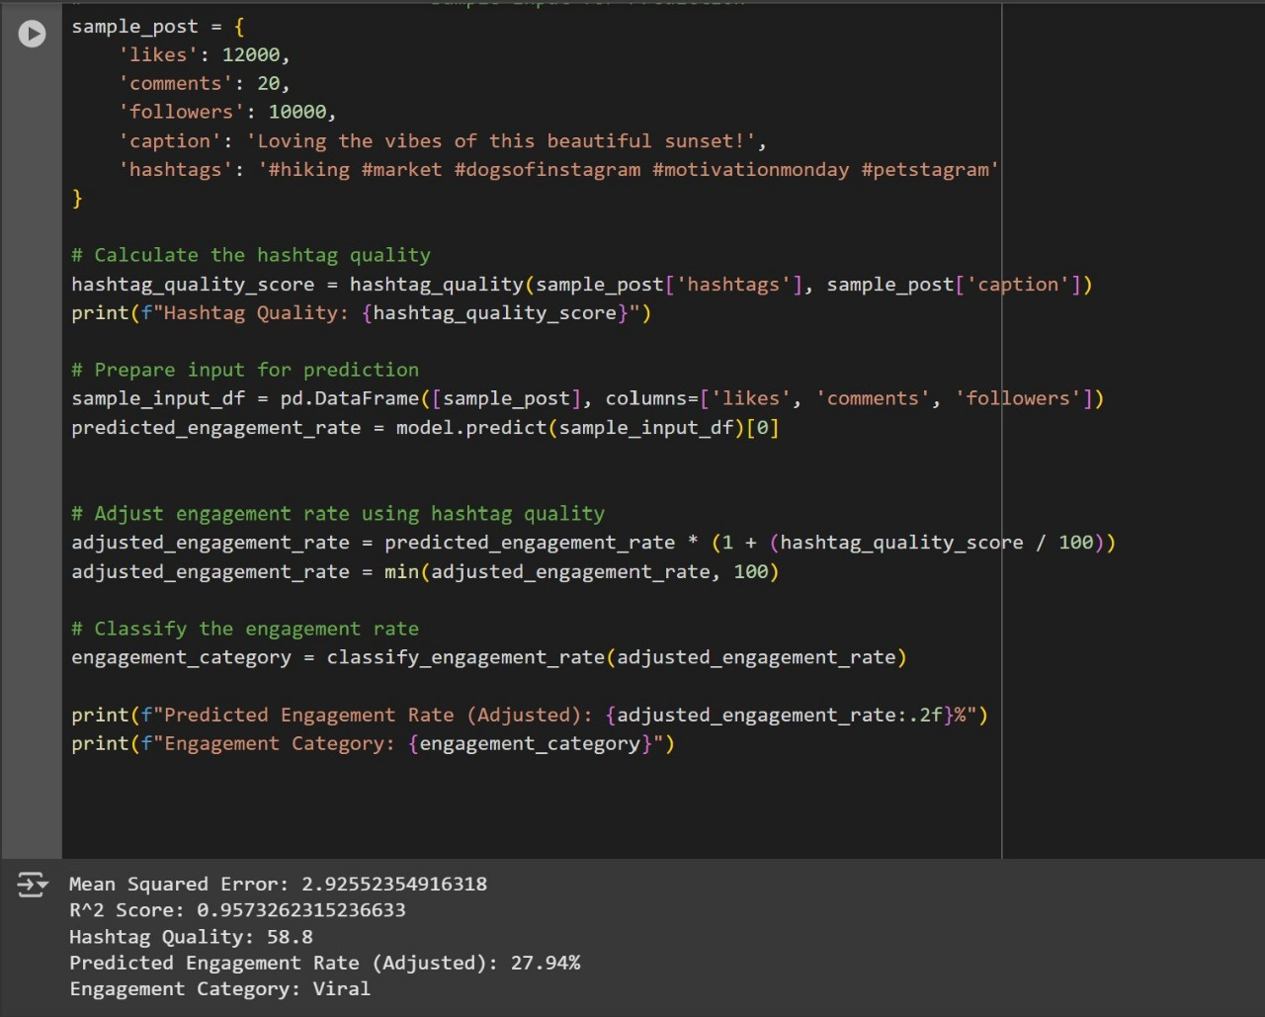
ER prediction based on user-history features, hashtag quality, input / generated caption
SOCIALWAVE - FINAL PRESENTATION
42

Slide 43
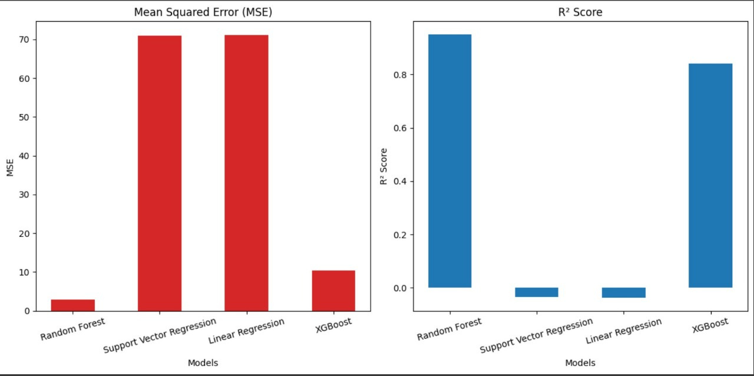
Bar Plot of ER Models
SOCIALWAVE - FINAL PRESENTATION
43

Slide 44

CONCLUSION
SocialWave is on track to develop an innovative tool aimed at helping budding content optimize their posts for higher engagement and virality. Our initial progress in data collection, algorithm selection, and feature implementation sets a solid foundation for the next phases of development. As we move forward, we will focus on integrating these components into a user-friendly application and refining our models to ensure accurate and impactful results for content creators. We are confident that SocialWave will offer valuable insights and practical tools to enhance social media strategy and success.
SOCIALWAVE - FINAL PRESENTATION
44

Slide 45

REFERENCES
Purba, Kristo Radion, David Asirvatham, and Raja Kumar Murugesan. "Instagram post popularity trend analysis and prediction using hashtag, image assessment, and user history features." Int. Arab J. Inf. Technol. 18.1 (2021): 85-94.
Silva, Singhe, and Rasika Rajapaksha. "Predictive Analysis on Social Media Content to Become Viral." , International Conference on Advances in Technology and Computing (ICATC 2023)
Srivastava, S., Divekar, A.V., Anilkumar, C. et al. Comparative analysis of deep learning image detection algorithms. J Big Data 8, 66 (2021).
Carta, Salvatore, et al. “Popularity prediction of instagram posts." Information 11.9 (2020): 453.
Maulud, Dastan, and Adnan M. Abdulazeez. “A review on linear regression comprehensive in machine learning." Journal of Applied Science and Technology Trends 1.2 (2020): 140-147.
SOCIALWAVE - FINAL PRESENTATION
45

Slide 46

THANK YOU!
SOCIALWAVE - FINAL PRESENTATION
46

